Slide 1
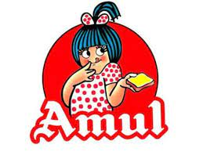
TITLE: Comprehensive -Digital-Marketing-For-Amul

Slide 2
The project presented by :
Names :
KURAPATI LOKESH ( TEAM LEADER AND PROJECT ANALYSER AND CREATED)
YERUKALA UMADEVI ( INFORMATED COLLECTED REGARDING THE PROJECT)
KOTTALA DHANUNJAYA (LOGOS AND PICS COLLECTED REGARDING THE PROJECT)
SAIK MOHAMMED AFREED ( COLLECTED THE SEO AUDIT, KEYWORD RESEARCH AND REGARDING RATIOS PICTURES
VALMIKI NITHIN (THE STRATEIES AND COMPETITORS INFORMATION COOLEECTED)
FROM :
SSGS AIDED DEGREE COLLEGE
2

Slide 3
> ​Research Brand: AMUL
MISSION: Satisfy the taste and nutritional requirements of the customers of t world, through excellence in marketing by our team. Through co-operative networking, we are committed to offering quality products that provide best value for money."
Values
* World's leading dairy products company.
* Maximum Revenue.
* Not harming nature and animals.
* Farmers and employees well being.

Slide 4
USP OF AMUL : the inexpensive cost of the amul brand is its key usp. by lowering the pricing for its product array, it hurts the multinationals. its "backward integration strategy," which significantly lowers costs, gives it a competitive advantage no middlemen: amul links milk producers directly with consumers; this strategy both safeguards producers against middlemen's scams and lowers the price of the products for consumers. farmers are in charge: farmers are in charge of the marketing, processing, and procurement. Brand Identity : amul is a renowned indian dairy brand known for its innovative and memorable brand identity. the amul girl one of the most iconi elements of amul's brand identity is the adora Brand Tone : However, Amul's tone is consistently kind and laid-back. By inventing their own slang phrases, they promote their products and brand. And the taste of india is tagline of amul brand. They potrate the tone with enjoyful and funny like childish.

Slide 5
Smart goals :
Organizational Goal : Business and strategic objectives that define Amul Dairy's mission are known as organizational goals. Organizational goals are long-term strategic objectives that Amul Dairy hopes to accomplish. Generally speaking, this time frame is lengthy. The objectives of Amul Dairy aid in guiding both the short-term company operations and the behavior of its employees.
Achievable Goal :The goals set by Amul Dairy should be achievable. This means that Amul Dairy should have the resources and the finances necessary for being able to realize the organizational goals over the long haul. Amul Dairy should also have the strategic leadership to be able to achieve these organizational goals.

Slide 6
6
Develop goals :
strategic : Examine and evaluate the vision statement.Determine the direction Amul Dairy should go over the next five years based on the vision statement and business values. Brainstorming :Set objectives that will assist Amul Dairy in achieving its long-term direction. group objectives based on themes. Group the objectives and give a brief description of each group and cluster.Set long-term objectives for the business based on several clusters and groupings. Prioritization :Group and prioritize various clusters and groupings.Establish and specify long-term objectives based on prioritizing.To create a good vision statement, prioritization should be based on how quickly the various objective groups and clusters will assist Amul Dairy advance and take the position it wants in the next five years or so.
Implement goals :
Communication :Share the objectives with all managerial levels.All necessary parties, such as distributors, stockholders, outside contractors, etc., should be informed of the goals.Customers may also be informed of goals.By outlining roles and milestones required for achievement, communication of goals will assist Amul Dairy in achieving its objectives.regular strategic analysis

Slide 7
Buyer’s/audience’s persona : Target Market for Amul With no luxury offers, Amul has focused on the Indian mass market and strives to deliver the highest-caliber goods at reasonable costs.Amul bases its pricing strategy on the low-cost price approach since it has in the past and continues to do so attract a lot of consumers.Let's now analyze Amul's target market in light of both customer- and sector-based targeting. The target market is divided by their approach into the following two groups:
Customer-Based Target Audience :
7
customers | Amul Products
kids | Chocolates, Amul cool, Amul milk.
youth | Amul pizza, Cheese, Cheese spread
Health conscious | Amul shakti, Amul lite Butter

Slide 8
Industry-based target audience
8
Amul has segmented Milk for various industries such as ice-cream manufacturers, restaurants, coffee shops, and many similar industries.
Further, it has segmented Butter, Ghee, and Cheese for bakeries, pizza, snack retailers, confectionaries, and many more.
The target audience study tells us that Amul has a strong presence in both business-to-business (B2B) and Business-to-Customers (B2C).
This is how Amul’s target audience is served, given that it has a decent concentration in both B2B and B2C segments. Let us understand the marketing strategies and campaigns implemented by them to market themselves in the next section of this case study.

Slide 9




swot analysis of amul
9
strenth
weaknesses
opportunity
threats
*Strong dependency on weak infrastructure & completely dependent on villages for its raw materials
Risks of highly complex supply chain system
* Short self life of its Product
*Alliance with third parties who do not belong to the organized sector
* Largest food brand in India & Asia
*High Quality, Low Price
* Introduced TQM
* World's Largest Pouched Milk Brand
*Annual turnover of 4300 Crore(2006-07)
§ Highly Diverse Product Mix
• Robust Distribution Network
* Penetrate international markets
*Diversify product portfolio to enter new product categories and expand existing categories
like processed
foods, chocolates ete.
Use internet to sell its products
*Competitors - Hindustan Lever, Nestle, Britannia and local players
*Stiff competition from MNCs in butter
*Growing price of milk and milk products

Slide 10
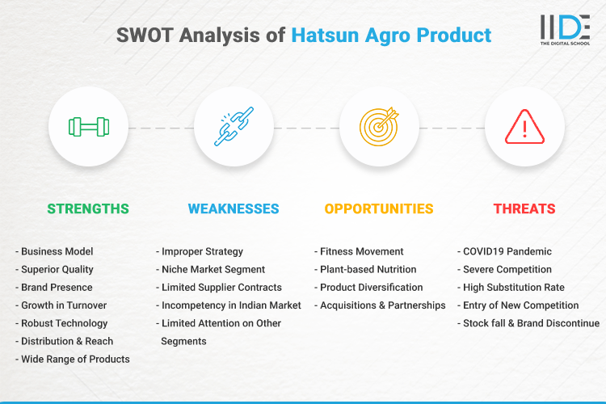
Competitor Analysis
10
COMPETITOR 1 : HATSUN

Slide 11
11
COMPeTITOR 2 : kwality wall
strength powerful brand nameexcellent visibility and advertising good availability and distribution of products There are several tastes and options available.
Weaknesses
. Food products have a limited shelf lifeThese were the weaknesses in the Kwality Walls SWOT Analysis. The weaknesses of a brand are certain aspects of its business which it can improve
Opportunities
Better and newer flavors. Above we covered the opportunities in Kwality Walls SWOT Analysis. The opportunities for any brand can include prospects of future growth.
Threat
from existing ice-cream brands Local Kulfis
The threats in the SWOT Analysis of Kwality Walls are as mentioned above. The threats for any business can be external factors which can negatively impact its business.
Threat from existing ice-cream brands

Slide 12
COMPETITOR 3 : cadbury
Strengths:
Cadbury is a well-known and well regarded chocolate brand.Customer loyalty and brand recall are high among Cadbury's clients.a workforce of about 70,000 peopleKraft Foods' strong parent brand provides a solid foundation.Cadbury's marketing and advertising strategies have been extremely effective.
Weaknesses:
Several debates on marketing, worms, and other topics made international headlines.The reputation of Cadbury was harmed by a few incidents of product recall.These were the SWOT Analysis shortcomings for Cadbury. A brand's shortcomings are specific areas of its company that may be strengthened.
Opportunities:
Cadbury can expand its market presence in rural areas.broadening its sphere of influence and entering unexplored marketsAdding rivals might strengthen Cadbury's position as the market leader.expansion of product offerings into adjacent food categories
Threats:
Health consciousness amongst people can reduce intake of chocolatesIncrease in cost of raw materialInflation can cause reduction in salesHigher competition form international and local chocolate brands can affect Cadbury's market share
12

Slide 13
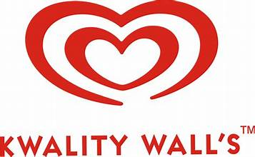

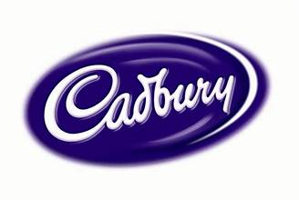
Competitors brand logos :
13

Slide 14
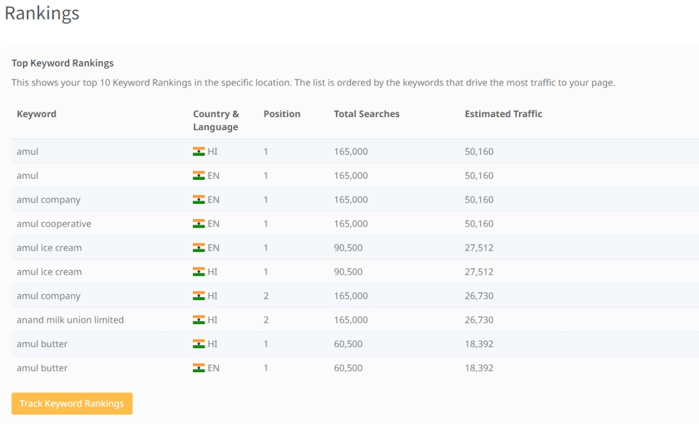
SEO AUDIT OF AMUL BRAND :
14

Slide 15
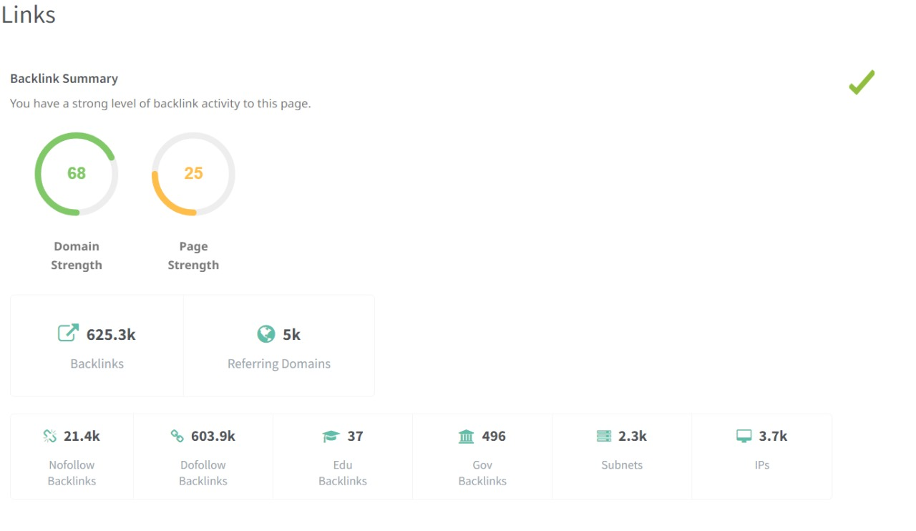
15

Slide 16
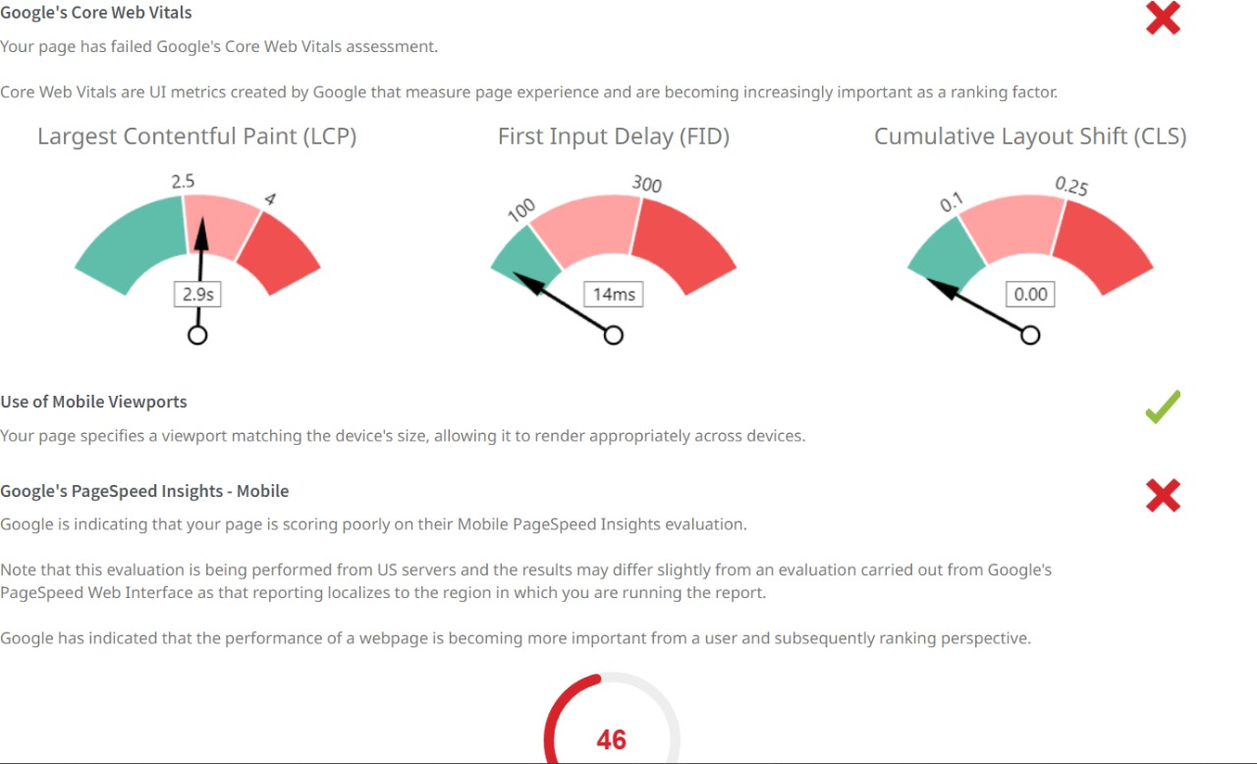
16

Slide 17
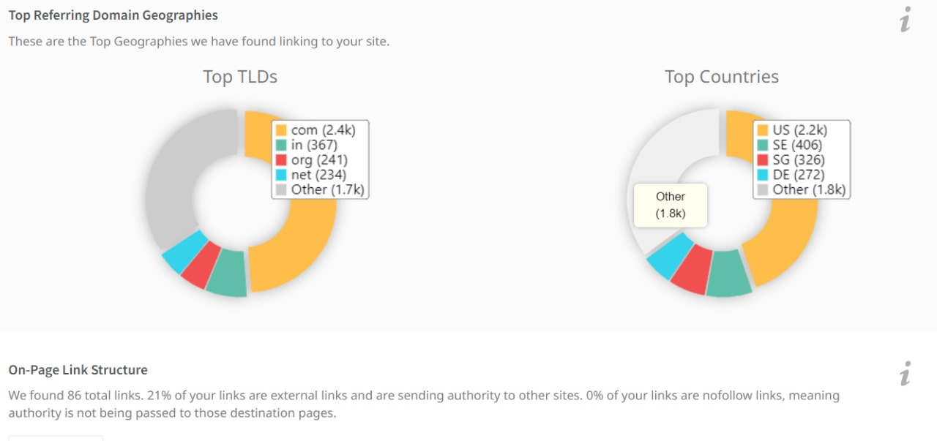
17

Slide 18
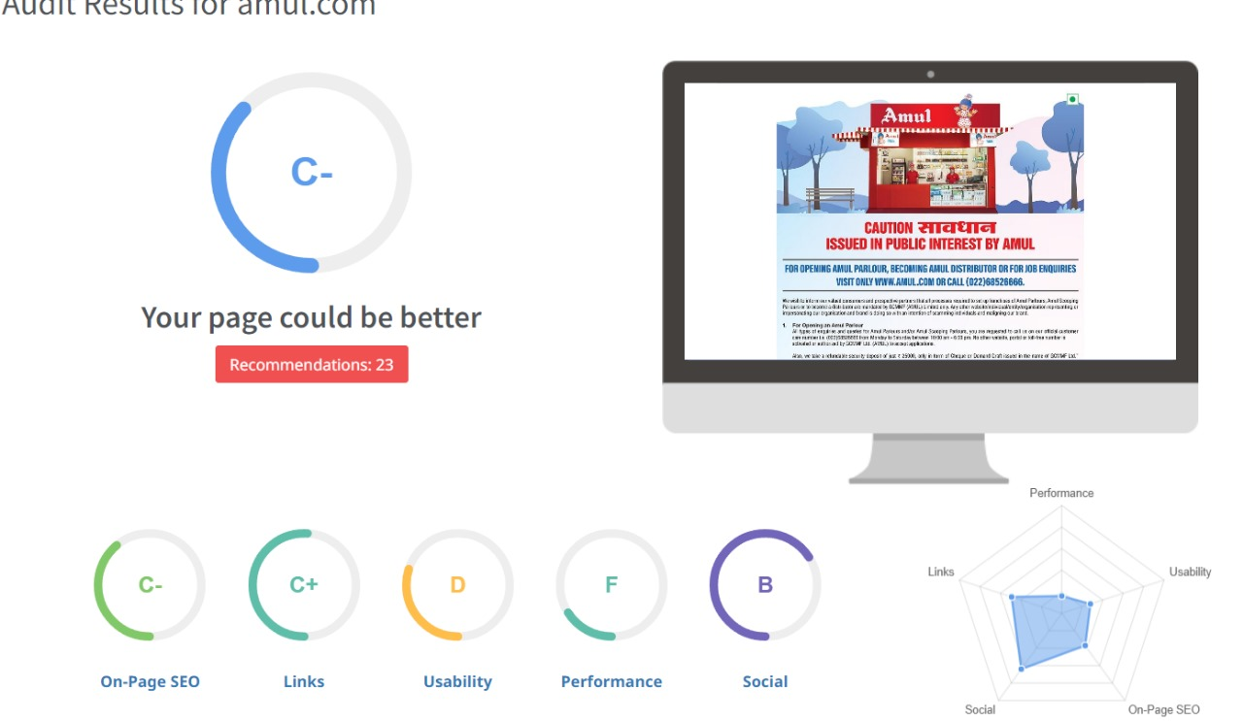

Slide 19
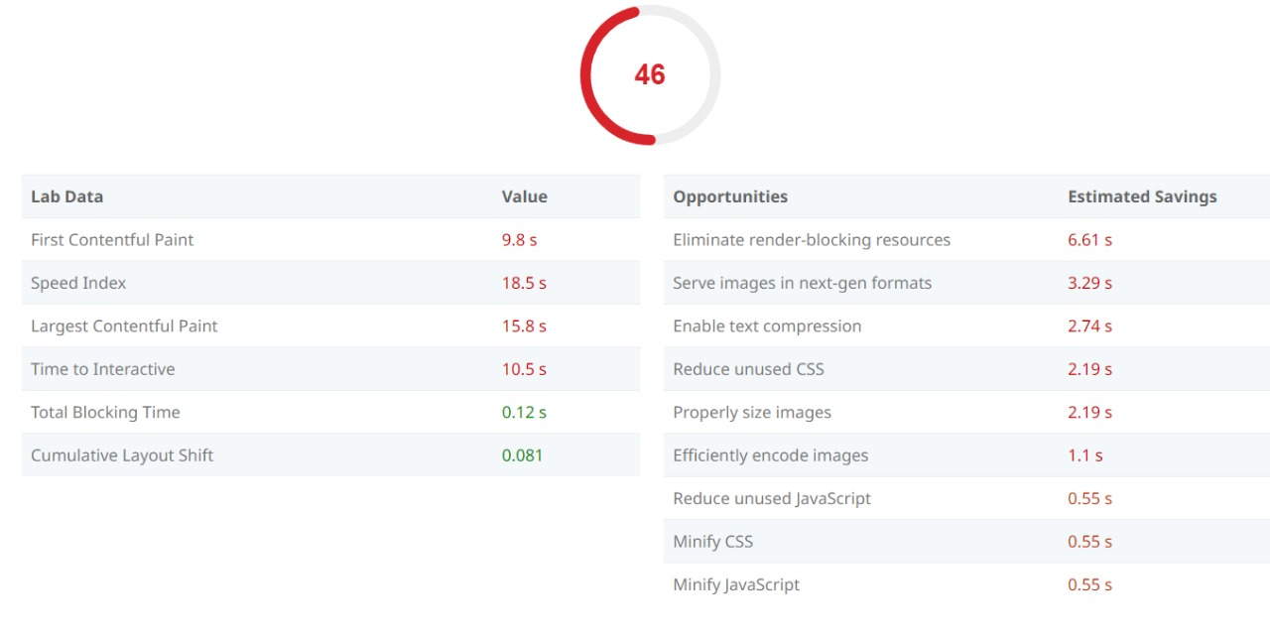

Slide 20
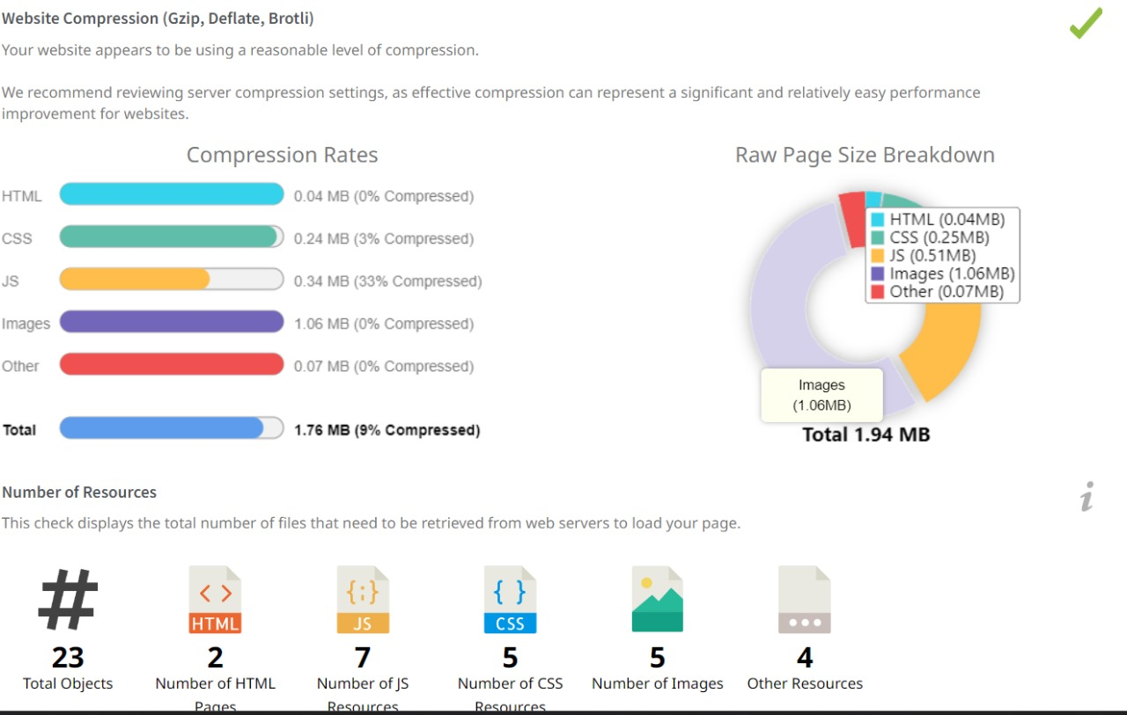

Slide 21


Slide 22
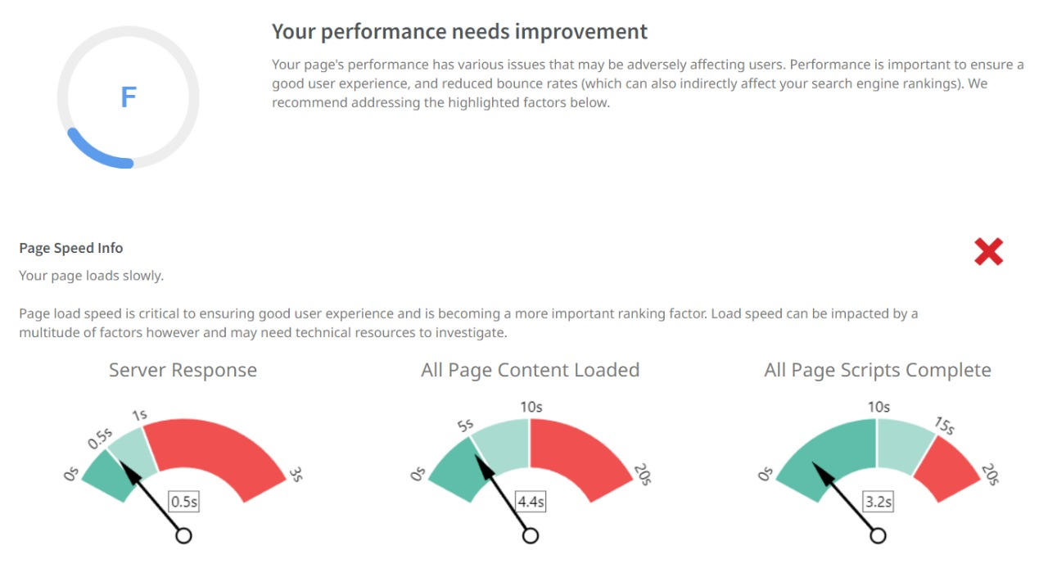
22

Slide 23
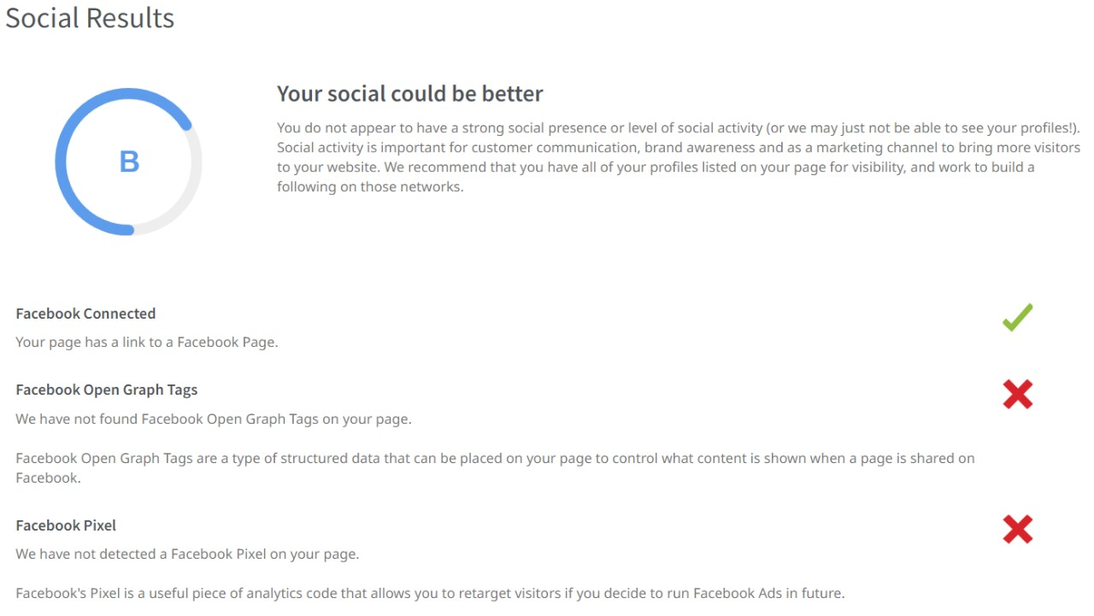
23

Slide 24
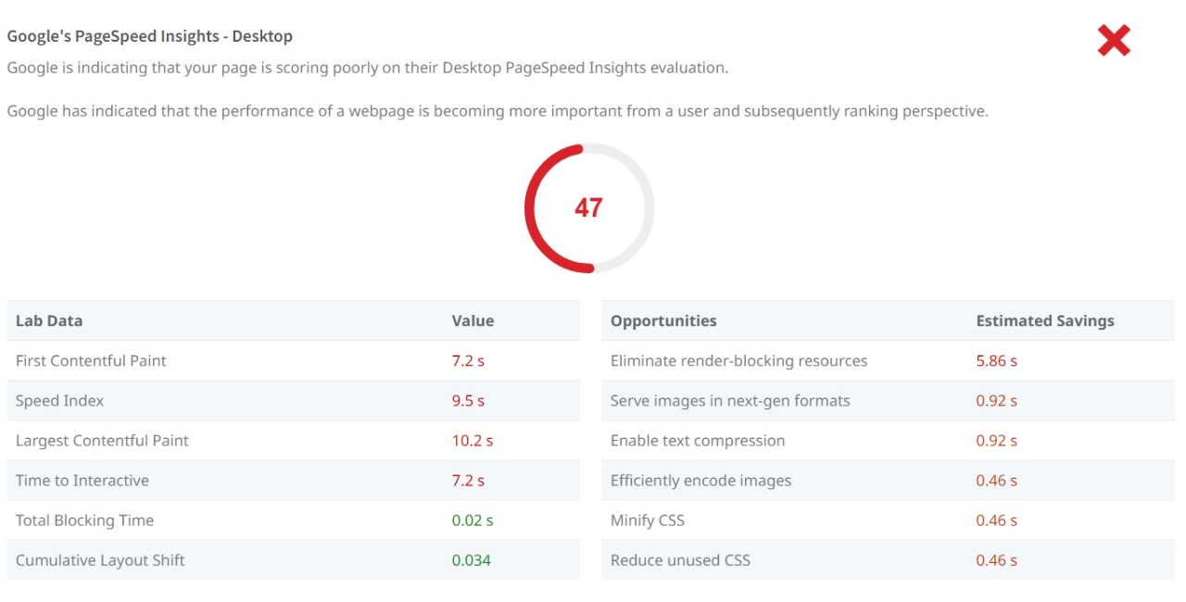
24

Slide 25
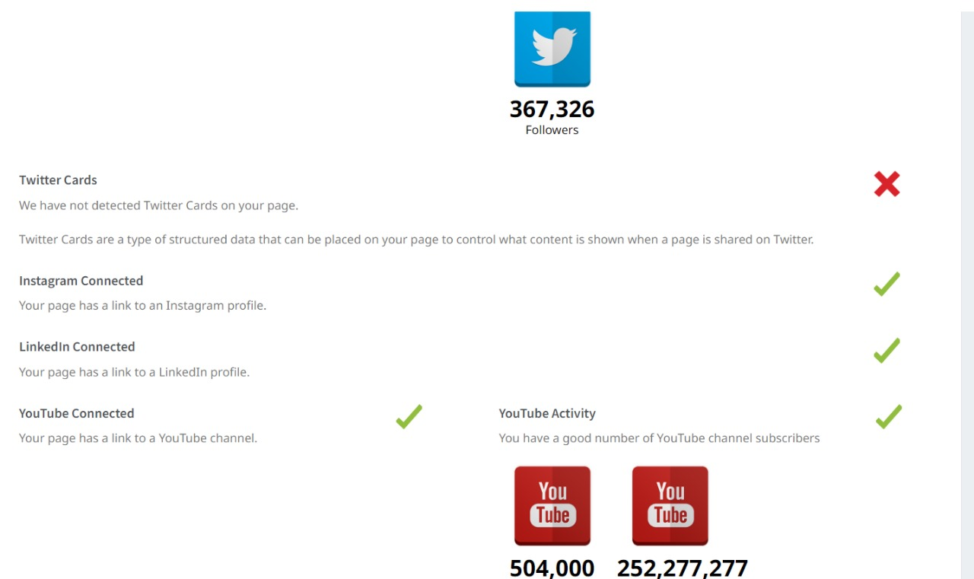
25

Slide 26
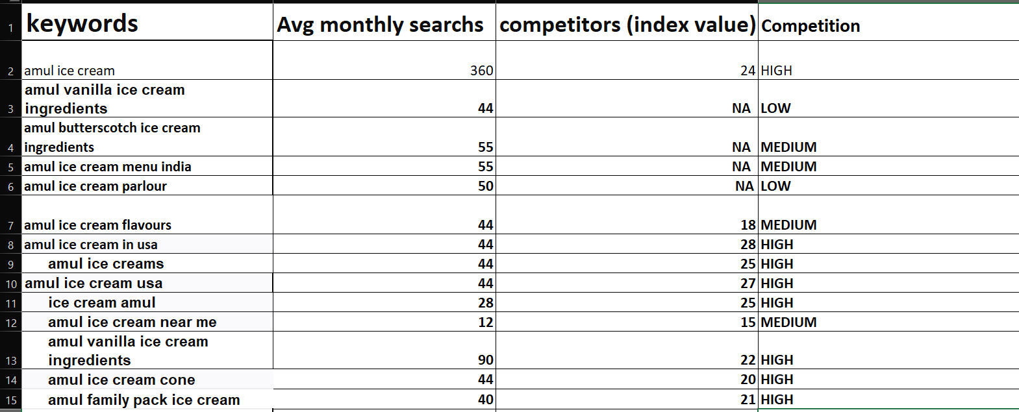
KEYWORD RESEARCH
26

Slide 27
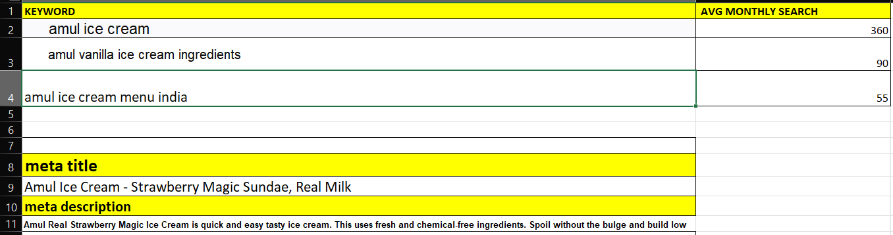
27

Slide 28
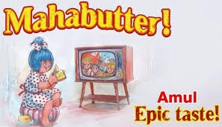
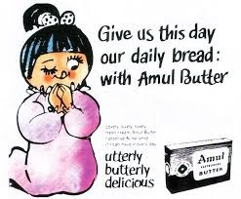

Content ideas and marketing strategies :
The Story of the Amul Girl, India’s Most Loved Ad Icon
The Amul brand's official mascot is Amul Girl. A little Indian girl in a polka-dot outfit with blue hair and a ponytail is depicted in the hand-drawn cartoon.
The Amul Girl was developed in 1967 as a counter to the butter-girl produced by Amul's competitor brand, Polson. It set a global record for the longest-running advertising campaign ever to take place on Earth!
Amul’s mascot strategy has worked out very well offline but lets us now check how is it working on the digital fronts.
Amul’s Digital Marketing Strategy
Every company needs to update its marketing plan in this more and more digital age. Like its rivals, Amul has reduced its spending on TV advertisements and begun putting more of an emphasis on web promotion.
Amul distinguishes itself as a national symbol not only because to its effective marketing approach but also due to the distinctive Amul stores and distribution facilities it has established throughout India.
As a result, the business has been able to communicate with customers directly and provide them with simple access to its products. As a result, its consumer base has grown significantly over time.
28

Slide 29
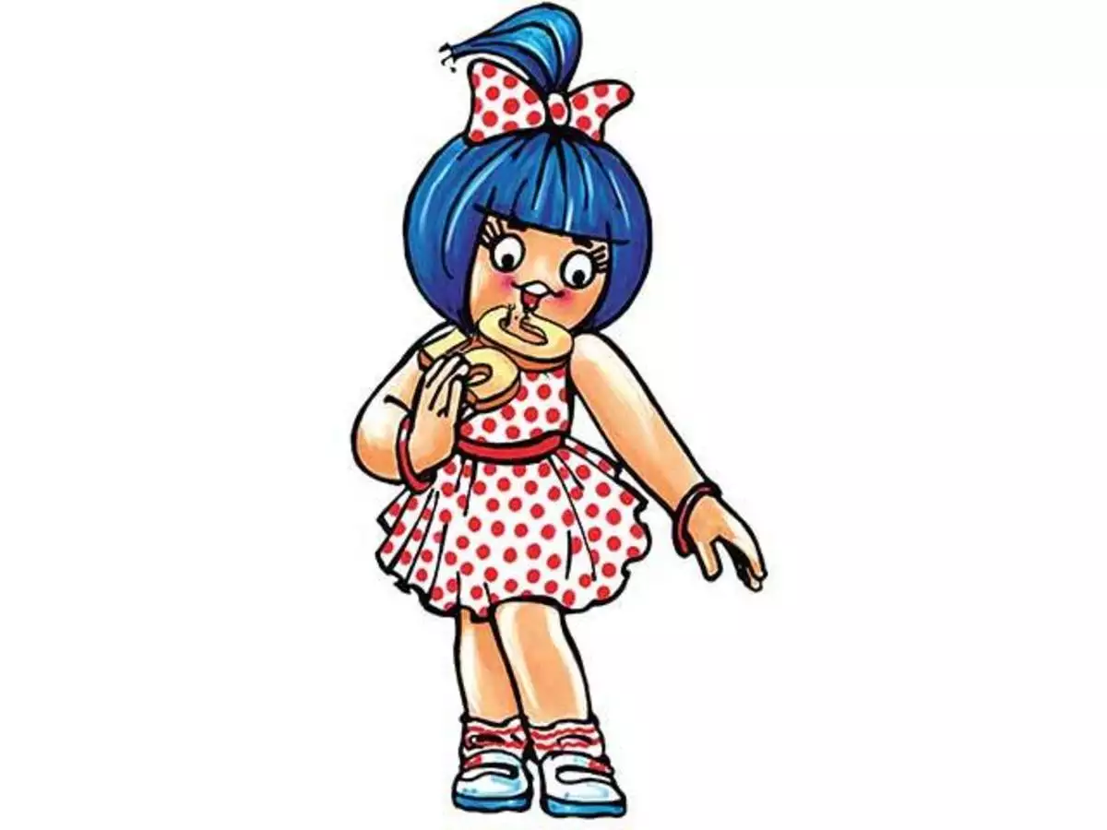
Top Marketing Campaigns of Amul
Amul Girl campaigns
The recognizable Amul butter girl, often known as the "Amul girl," personifies all that is delightfully innocent and entertaining about India. The Polson's Butter Girl, a product of Amul's competitor firm that ultimately became the symbol of Amul, inspired the creation of the Amul girl.
The Amul girl's appearance was purposefully created to evoke the image of a warm, jovial person who could be identified with by customers from all walks of life. When a 1967 commercial with the Amul girl was published, she finally became the brand's face.
Amul's Moment Marketing Plan
Amul has been using a moment marketing strategy for a while. It was formerly used in newspapers, and it is now also found on well-known social media platforms. Moment marketing starts relevant client contacts by referencing topical events and popular culture. Additionally, it helps businesses establish connections with and discover points of commonality with their consumers.Moment-based marketing typically exhibits wit, engagement, relatability, spontaneity, and a sense of the present. Amul has been far ahead in the field of moment marketing ever since it started airing pertinent advertising in 1966. This outdoor advertisement has aired for the longest time ever. Amul uses its iconic "utterly butterly girl" to keep its brand current by using the news of the day in unique and inventive ways.
29

Slide 30
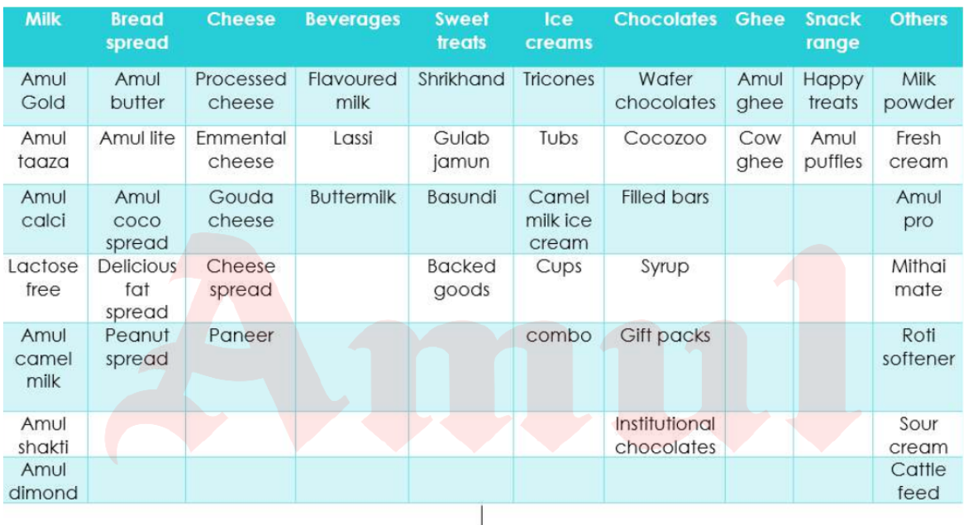
Amul products table
30

Slide 31
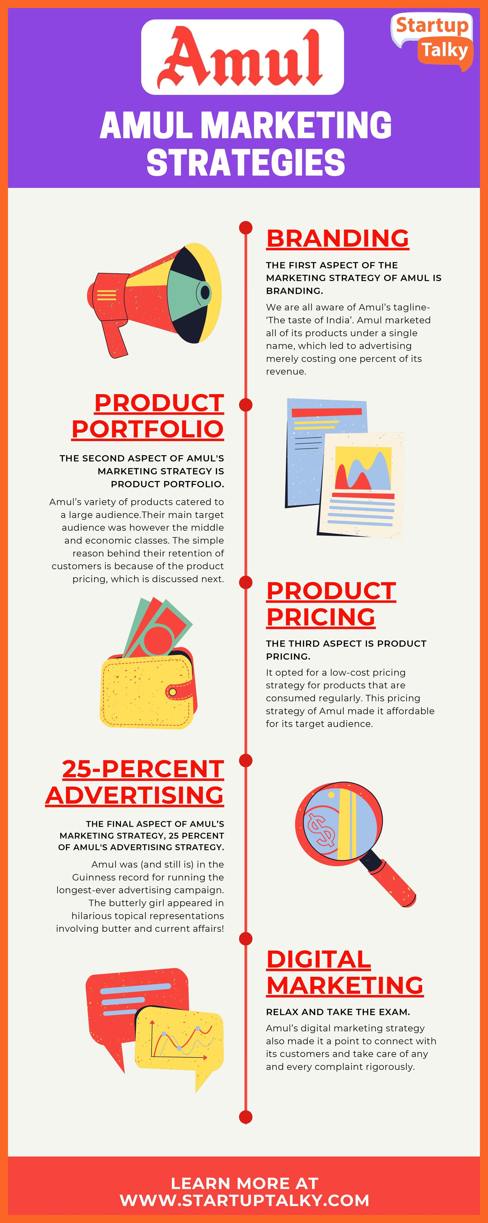
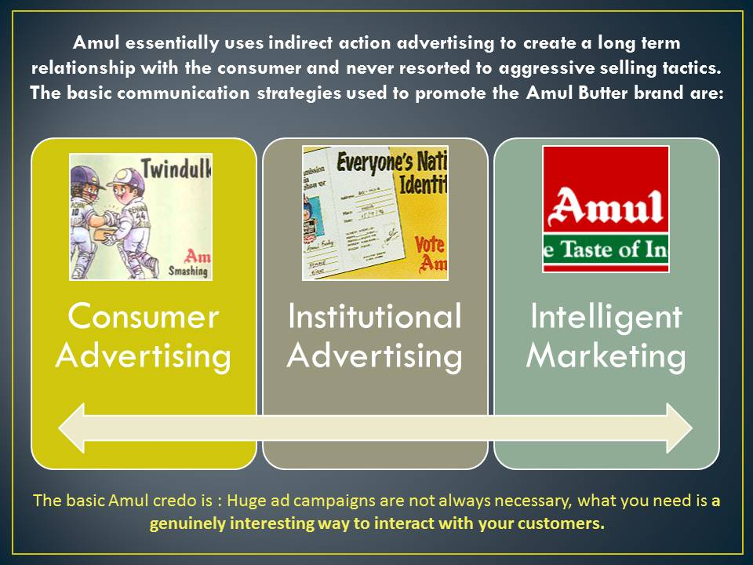
Amul marketing ideas and strategies chat :
31

Slide 32
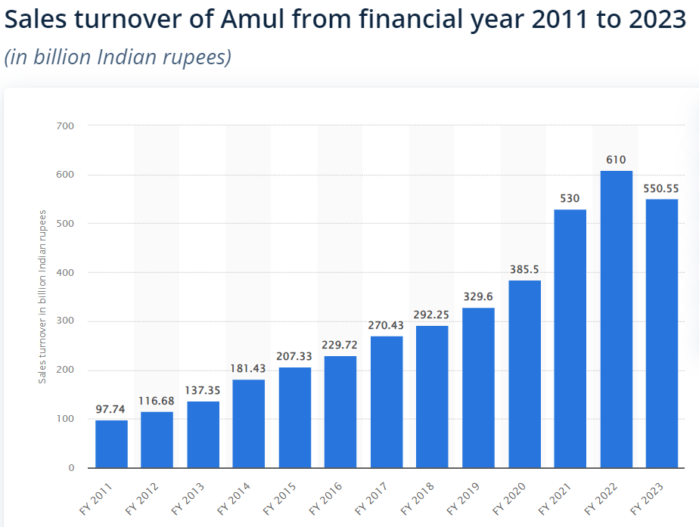
32

Slide 33
Format :1
Content creation and curation :
Recent updates of amul :
Amul hikes milk prices by Rs 2 per litre in Gujarat
Gujarat Co-operative Milk Marketing Federation (GCMMF) which markets dairy products under the brand name Amul has decided to increase milk prices with effect from Saturday (April 1) morning.
Amul hikes milk price by up to Rs 3/litre
Post this revision, the price of Amul Gold will be Rs 66 per litre , Amul Taaza will be Rs 54 per 1 litre, and Amul cow milk Rs 56 per litre and Amul A2 buffalo milk will now cost Rs 70 per litre, it said in a statement on Thursday.
Amul vs Nandini: Milk war hots up in Karnataka
Nandini is also keeping price points low at Rs 39 a litre for its packet milk, in a bid to protect its market, dairy industry sources said, even as Amul will retail its milk at higher price points in the capital of Karnataka.
Dairy brands Amul and Nandini will compete with each other in Bengaluru, one of the country’s largest milk markets, as the former makes an entry into the same.
Amul announced on Wednesday that it was entering the Bengaluru market, via e-commerce channels. The announcement created a social media storm, with hashtags such as #SaveNandini and #GobackAmul doing the rounds
Marketed by the Karnataka Milk Federation (KMF), Nandini is the largest supplier of milk in Bengaluru, at 23 lakh litres per day, which is about 70% of Bengaluru’s milk market, pegged at 33 lakh litres per day, according to dairy industry sources. Nandini is also keeping price points low at Rs 39 a litre for its packet milk, in a bid to protect its market, dairy industry sources said, even as Amul will retail its milk at higher price points in the capital of Karnataka.
33

Slide 34
Format :2
Debate between the milk brands Amul and Nandini
Amul is a well-known milk brand owned by the Gujarat Cooperative Milk Marketing Federation, whereas Nandini is a well-known milk brand owned by the Karnataka Milk Federation.
• Both are strong cooperative movements with thousands of dairy producers involved. The controversy was sparked by Amul's recent announcement that its goods will be sold in Bengaluru
.• In the lead-up to the elections, some have attempted to take advantage of the circumstance and instigate a discussion around the "outsider - sons of the soil" faultline.
• It's interesting to note that during the demonstrations and clashes, both GCMMF and KML sat as outsiders.
• Those demonstrating against Amul suggested that the company was attempting to supplant the Nandini brand.The discussion is distinctive since none of the cooperatives genuinely engaging in it are active combatants.
• In addition, there are two opposing viewpoints on the contemporary geopolitics of milk.
o Because we are a one nation, all goods, services, and brands must travel freely across it.
o Because a cooperative movement's culture is primarily local, outside intrusions must be prevented.
Is it all about politics?
The major players in the region, such as the Congress, JD(s) and BJP, stake their claims in the local elections and share assembly seats among them.
As with politics anywhere, they highlight milk cooperative issues to influence voters.
However, these are non-issues as per the local functionaries who say increasing procurement prices, waiving farm loans, and listing fodder prices should be in the focus.
34

Slide 35

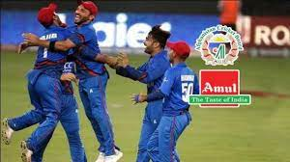
Format :3
Amul is official sponsor of the Afghanistan Cricket team for ICC World Cup :
Amul has been exporting dairy products to Afghanistan for 20 ..
Amul is the principal sponsor of the Afghanistan cricket team for the upcoming ICC Cricket World Cup hosted by England and Wales. Amul's logo will appear on the leading arm of Afghanistan team playing jerseys as well as on the training kits throughout the World Cup from May 30 to July 14, 2019. Commenting on the partnership, GCMMF Managing Director Dr. RS Sodhi said, "We are excited about being associated with Afghanistan Cricket for the first time and Amul is hopeful that this team, rated as the fastest growing team in International cricket, will deliver outstanding performance in the World Cup". He added, “Amul and Afghanistan share an old association. Khan Abdul Ghaffar Khan, popularly known as Frontier Gandhi had visited Amul in 1969 and had met Dr. V Kurien and studied the activities of our dairy cooperative.” Subsequently, several delegations of women milk producers from Afghanistan have visited Amul. Amul is a strong model of rural upliftment and women empowerment which has been recognised by the people of Afghanistan. Amul is also exporting its milk powders and baby food to Afghanistan since last 2 decades. Commenting on the association, Asadullah Khan, CEO of Afghanistan Cricket Board said "This is a big moment for Afghanistan cricket and we are extremely happy that Amul will sponsor us for the World Cup. This is the first time we will play in the World Cup as a full member and the preparations are good. We hope to do well". The ODI tournament sees Afghanistan team with a very good preparation heading to England with a number of key in form players fresh from IPL. The Afghanistan team will play a warm up match with Pakistan on 24th May and with England on 27th May.
35

Slide 36
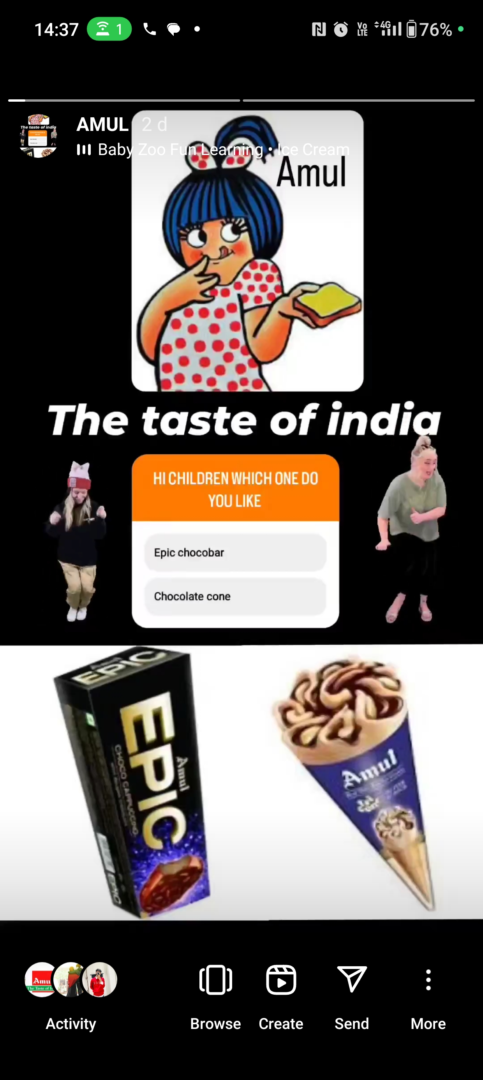
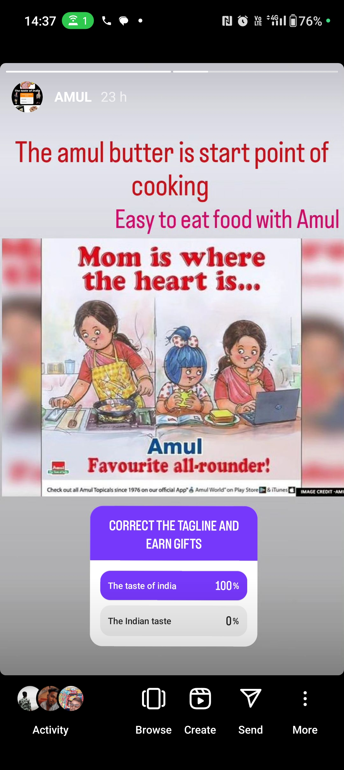
Instagram stories/highlights : :https://www.instagram.com/s/aGlnaGxpZ2h0OjE4MDI3MjkwMDg2NjM4NzIw?story_media_id=3213533984831418727_62405125644&igshid=NTc4MTIwNjQ2YQ==
https://www.instagram.com/s/aGlnaGxpZ2h0OjE4MDI3MjkwMDg2NjM4NzIw?story_media_id=3214051242532075324_62405125644&igshid=NTc4MTIwNjQ2YQ==
36

Slide 37
Conclusion :
According to the poll, Amul milk has a respectable market share. The results of the study allow for the following deductions. In order for aspirations to become realities and for liabilities to become assets, one must be able to satisfy consumers' requirements. Before buying milk, the buyer takes into account freshness, flavor, thickness, and accessibility. Finally, I draw the conclusion that the majority of customers are happy with Amul milk and milk products because of its high quality, positive reputations, and accessibility. Because of the Amul Milk's high price, poor dealer services, spoilage, and short shelf life, among other factors, some customers are not happy. however, if a little change is made to the marketing strategy, such as adding dealers and outlets or increasing promotion. Programmers, product lines, etc., may all help a business become a monopoly and a dominant market force. Before making any decisions, Amul must also examine its rivals and, more crucially, its customers.
37

Slide 38
THANK YOU
38

